Slide 1


JAVA Java Interview boot camp Core concepts
Lecture 20
CHAPTER 18
Nested/Inner Classes

Slide 2
Local Inner Class
A local inner class is defined in a code block (for example in a method body).
Unlike static nested classes and inner classes, local inner classes are not members of an outer class; they are just local to the method or code in which they are defined.
Syntax:
class SomeClass { void someFunction() { class Local { } } }

Slide 3
Instantiating Local Inner Class
When we declare the inner class it doesn’t mean we created an instance of it.
So to use the inner class, we must make an instance of it somewhere within the method but below the inner class definition(or the compiler won’t be able to find the inner class)

Slide 4
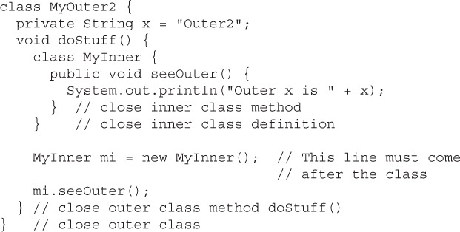
Instantiating Local Inner Class
Must appear only after closing brace of inner class

Slide 5
Where Can We Instantiate Local Inner Class ?
A method-local inner class can be instantiated only within the method where the inner class is defined.
In other words, no other code running in any other method—inside or outside the outer class—can ever instantiate the method-local inner class.

Slide 6
What Inner Class Instance Cannot Do ?
The inner class object cannot use the local variables of the method the inner class is in.

Slide 7
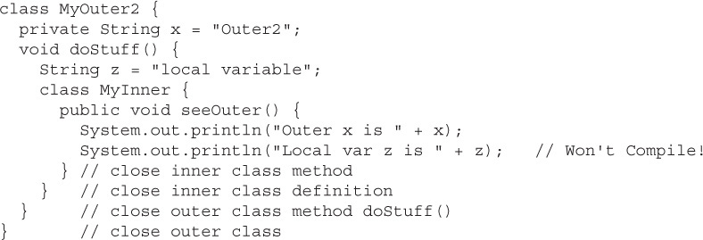
What Inner Class Instance Cannot Do ?
This is OK!
This is not allowed!

Slide 8
Why Is It So ?
The local variables of the method live on the stack and exist only for the lifetime of the method.
When the method ends, the stack frame is blown away and the variable is removed.
But even after the method completes, the inner class object created within it might still be alive on the heap

Slide 9
Why Is It So ?
For example, a reference to inner class object was passed into some other code.
Because the local variables aren’t guaranteed to be alive as long as the method-local inner class object is, the inner class object can’t use them.

Slide 10
Solution
Declare the variable as final
Marking the local variable z as final fixes the problem:
final String z = "local var"; // Now inner object // can use it

Slide 11
Modifiers Applied To Local Inner Class
The same rules which apply to modifiers about local variables also apply to method-local inner classes
We can’t, mark a method-local inner class as public, private, protected, static and transient, and the like.
For the purpose of the interview, the only modifiers we can apply to a method-local inner class are abstract and final

Slide 12
Anonymous Inner Class
An anonymous inner class is the same as a local inner class with one difference: it does not have a name.
Since it does not have a name, it cannot have a constructor.
So then how we can create objects of an anonymous class if it does not have a constructor ?

Slide 13
Anonymous Inner Class
An anonymous class is a one-time class.
We define an anonymous class and create its object at the same time.
We cannot create more than one object of an anonymous class.

Slide 14
Anonymous Inner Class
Since anonymous class declaration and its object creation are interlaced, an anonymous class is always created using the new operator as part of an expression.
The general syntax for creating an anonymous class and its object is as follows:
new <interface-name or class-name> (<argument-list>) { // Anonymous class body goes here }

Slide 15
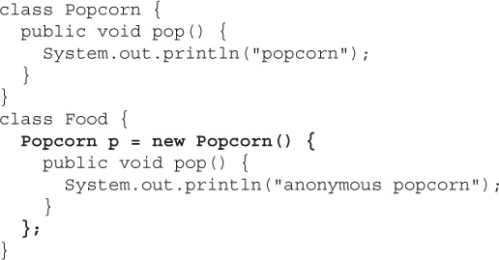
Anonymous Inner Class
This is where the anonymous class is starting
This is where the anonymous class is ending

Slide 16
Analysis Of The Code
We define two classes: Popcorn and Food.
Popcorn has one method: pop().
Food has one instance variable, declared as type Popcorn.
Food has no methods.

Slide 17
Analysis Of The Code
Now the most important thing :
Can you tell to whom p is referring ?
The Popcorn reference variable p refers not to an instance of Popcorn, but to an instance of an anonymous (unnamed) subclass of Popcorn.

Slide 18
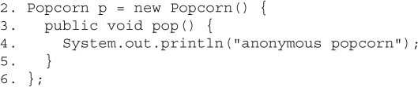
Analysis Of The Code
Declare a reference variable , p , of type Popcorn. Then declare a class that has no name but that is a subclass of Popcorn and here is the curly brace that opens class body
Look at the code again: How is line 2 read ?

Slide 19
Analysis Of The Code
Line 3 is the first statement within the new class and is actually overriding the pop() method of the superclass Popcorn. This is the whole point of making an anonymous inner class—to override one or more methods of the superclass!(or to implement methods of an interface)
Look at the code again: How is line 3 read ?

Slide 20
Analysis Of The Code
Line 4 is the first (and in this case only) statement within the overriding pop() method. Nothing special there.
Look at the code again: How is line 4 read ?

Slide 21
Analysis Of The Code
Look at the code again: How is line 5 read ?
Line 5 is the closing curly brace of the pop() method. Again Nothing special.

Slide 22
Analysis Of The Code
Look at the code again: How is line 6 read ?
Line 6 includes a curly brace closing off the anonymous class definition. But it also has the semicolon that ends the statement started on line 2—the statement where it all began—the statement declaring and initializing the Popcorn reference variable. And what you’re left with is a Popcorn reference to a brand-new instance of a brand-new, just-in-time, anonymous (no name)subclass of Popcorn.

Slide 23
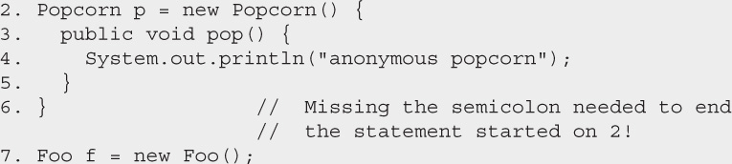
Caution!!! Be Careful!
The closing semicolon is hard to spot. Watch for code like this: You’ll need to be especially careful about the syntax when inner classes are involved, because the code on line 6 looks perfectly natural. It’s rare to see semicolons following curly braces.

Slide 24
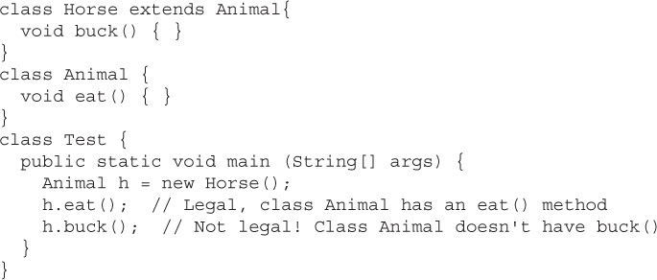
Another Point To Remember!!!
Rules of Polymorphism are in action when anonymous inner classes are involved.
We can only call methods on an anonymous inner class object that are defined in the reference variable type

Slide 25
Another Point To Remember!!!
So in the interview, we must be able to spot an anonymous inner class that—rather than overriding a method of the superclass—defines its own new method.
The method definition isn’t the problem, though; the real issue is, how do you invoke that new method?

Slide 26
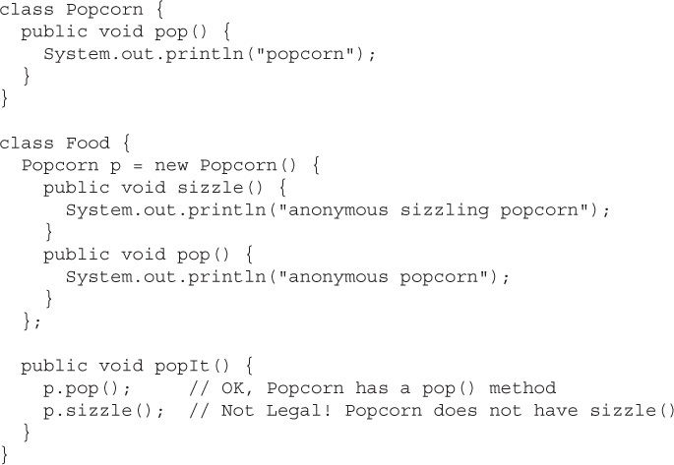
Another Point To Remember!!!

Slide 27
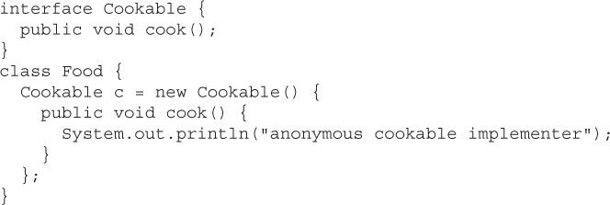
Second Way Of Writing Anonymous Class
We can also create an anonymous implementer of the specified interface type

Slide 28
Second Way Of Writing Anonymous Class
The code below , like the Popcorn example, still creates an instance of an anonymous inner class, but this time, the new just-in-time class is an implementer of the Cookable interface.
Also note that this is the only time you will ever see the syntax:
new Cookable()

Slide 29
Second Way Of Writing Anonymous Class
So how do we read the statement
Cookable c = new Cookable() {
“Declare a reference variable of type Cookable that, obviously, will refer to an object from a class that implements the Cookable interface”.

Slide 30
Point To Remember!!!
One more thing to keep in mind about anonymous interface implementers—they can implement only one interface.
There simply isn’t any mechanism to say that our anonymous inner class is going to implement multiple interfaces.

Slide 31
Point To Remember!!!
In fact, an anonymous inner class can’t even extend a class and implement an interface at the same time.
The inner class has to choose either to be a subclass of a named class—and not directly implement any interfaces at all—or to implement a single interface.

Slide 32
Caution!!! Be Careful!
The following is not legal:
whereas the following is legal, because it’s instantiating an implementer of the Runnable interface (an anonymous implementation class):

Slide 33
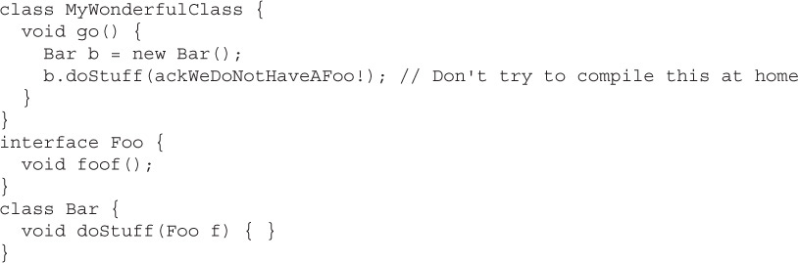
Third Way Of Writing Anonymous Class
Consider the following:
How will you call the method doStuff( ) ?

Slide 34
Third Way Of Writing Anonymous Class
One solution is to first create a class that implements Foo, and then we need an instance of that class to pass to the Bar class’s doStuff() method.
A much better solution is simply define an anonymous inner class, right inside the argument.

Slide 35
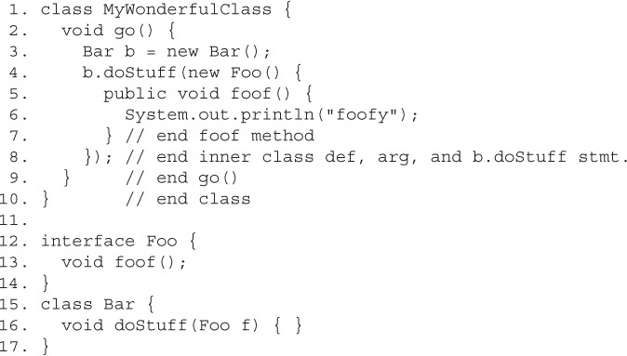
Third Way Of Writing Anonymous Class

Slide 36
Analysis Of Code
We’re calling doStuff() on a Bar object, and we make both an implementation class and an instance of that class, all right here in the argument to doStuff().
So that’s what we do. We write
new Foo() {
We start the new class definition for the anonymous class that implements the Foo interface.
Foo has a single method to implement, foof(), so on lines 5, 6, and 7, we implement the foof() method.

Slide 37
Analysis Of Code
Then on line 8—more strange syntax appears.
The first curly brace closes off the new anonymous class definition.
But this all happened as part of a method argument, so the closing parenthesis,), finishes off the method invocation, and then we must still end the statement that began on line 4, so we end with a semicolon.

Slide 38
Two Ways To Terminate Anonymous Inner Class
There are two ways to terminate the body of an anonymous class :
If they’re argument local, they end like this:
});
But if they’re just plain-old anonymous classes, then they end like this:
};

